Slide 1

What’s he doing?

Slide 2

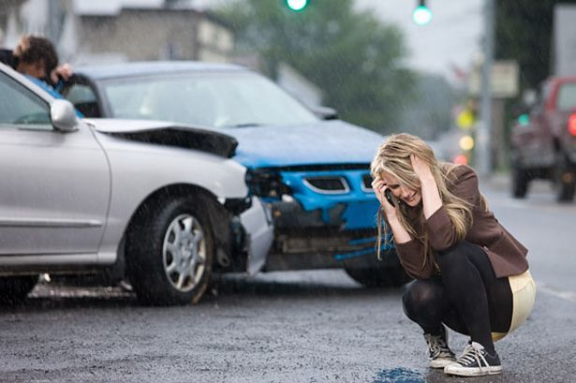

Slide 3
Distracted Driver Detection
Team 4
Haoyang Chen Jingwei Li Aoyuan Liao Qiner Shi

Slide 4

Agenda
Project Description
Model Performance
Feature Extraction
Feature Exploration
Feature Selection
Feature Structure
Prediction Refinement Using Time Series
Defective Point Detection

Slide 5
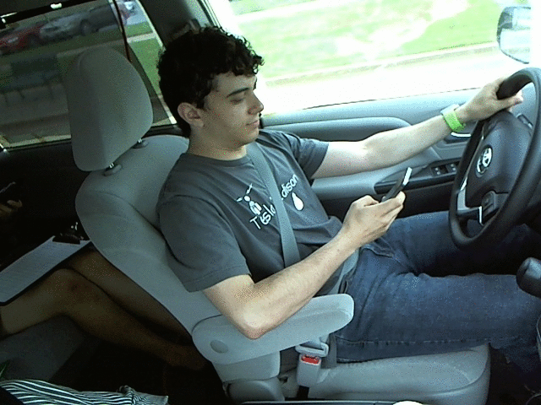
Project DESCRIPTION
Goal :
predict the likelihood of what the driver is doing in each picture
Class:
c0: safe driving
c1: texting – right
c2: talking on the phone – right
c3: texting – left
c4: talking on the phone – left
c5: operating the radio
c6: drinking
c7: reaching behind
c8: hair and makeup
c9: talking to passenger

Slide 6
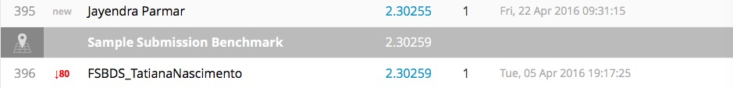

Model Performance
Loss Function : Log-Loss
Benchmark on Kaggle
Our performance

Slide 7
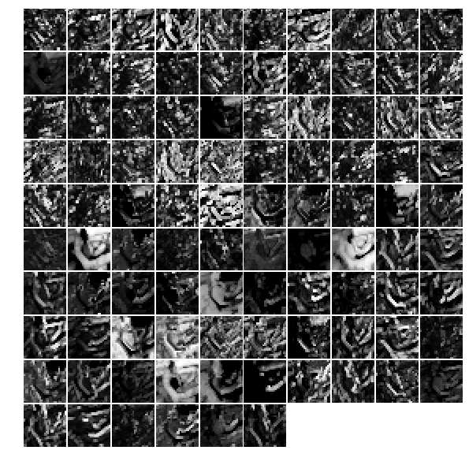
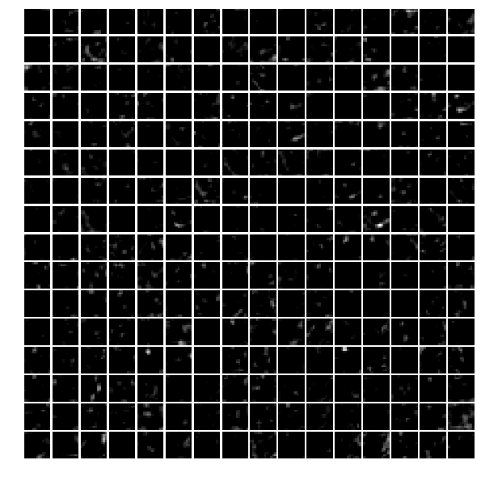
fEATURE eXTRACTION
CAFFE

Slide 8
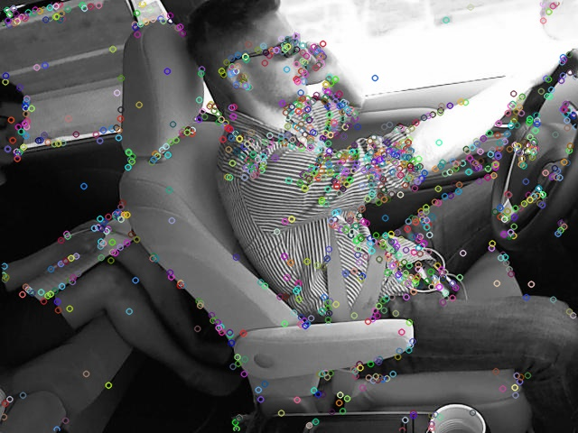
fEATURE eXTRACTION
OPENCV
No ideal feature given by SIFT
PIXEL

Slide 9

Feature Exploration
Using t-nse for clustering

Slide 10
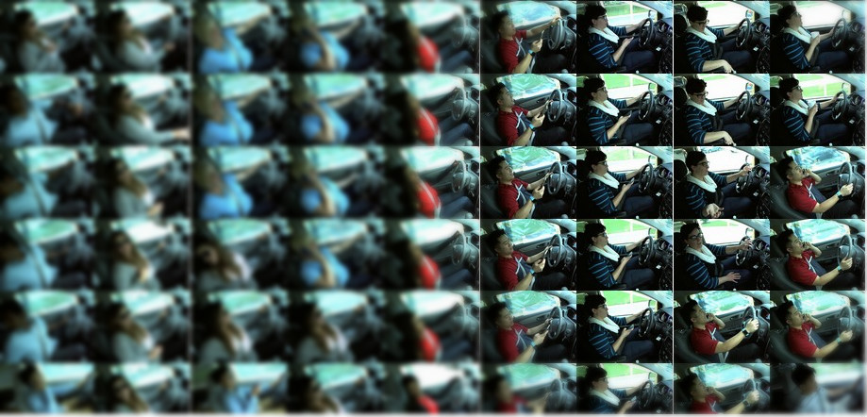
Feature Exploration
Using t-nse for clustering

Slide 11
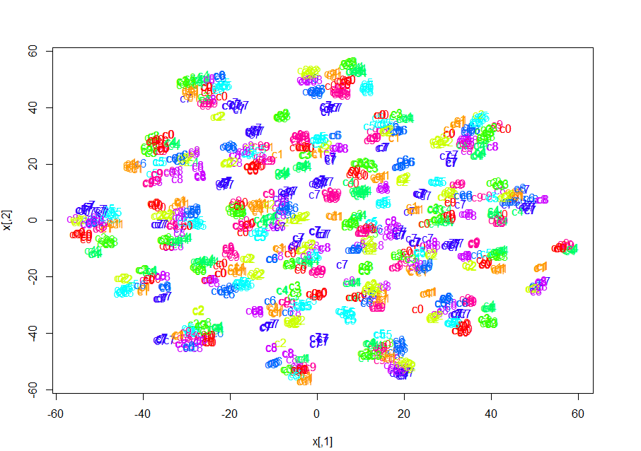
Feature Exploration
t-nse with labels

Slide 12
Feature SELECTION
Extreme Gradient Boosting

Slide 13
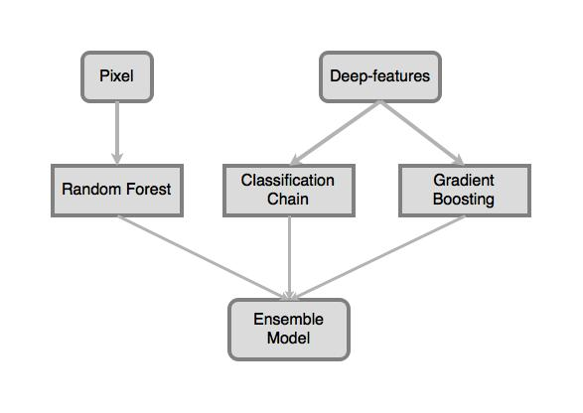
Model structure
Gradient boosting
Classifier chain
Random forest

Slide 14
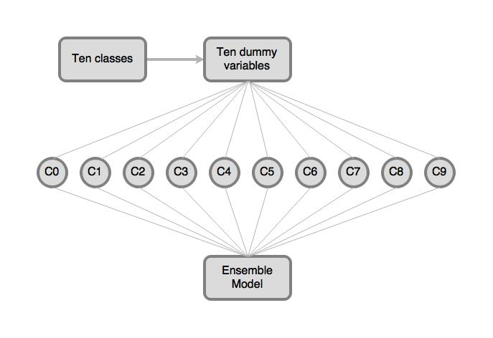
Classifier Chain
Gradient boosting

Slide 15
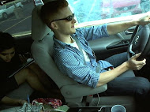
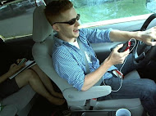
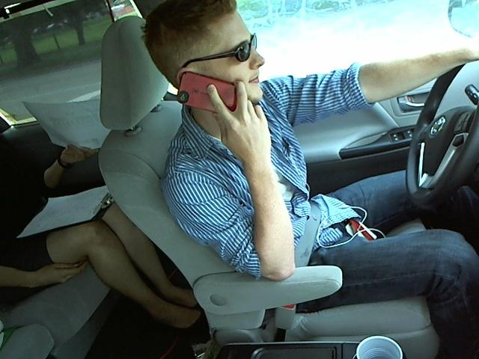
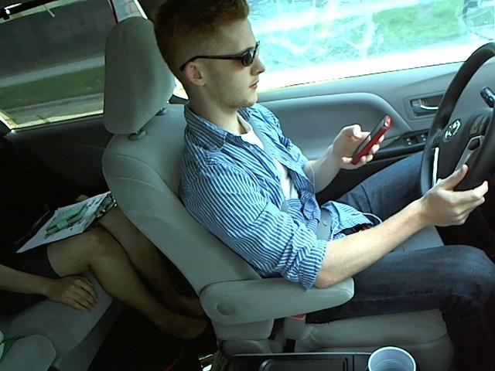
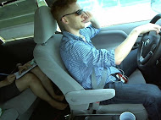
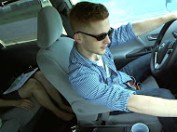
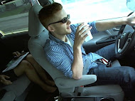
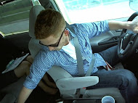
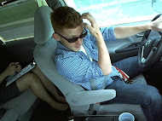
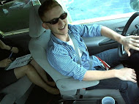
Drinking
Phone left
Hair
Behind
Phone right
Radio
Talking
Safe driving
Text left
Text right

Slide 16
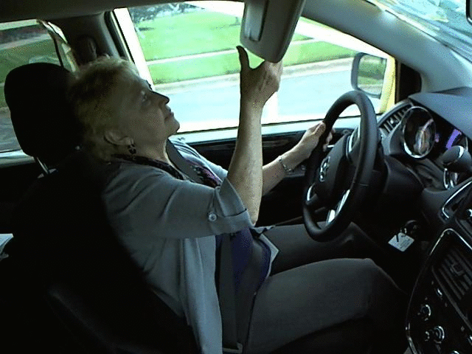
pREDICTION rEFINEMENT uSING tIME SERIES

Slide 17
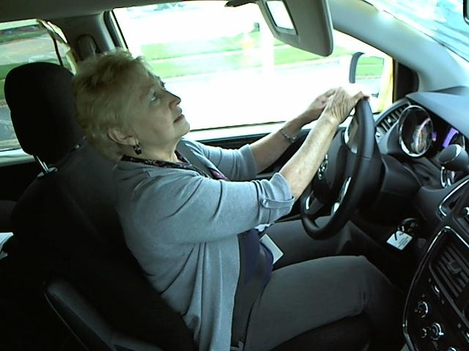
pREDICTION rEFINEMENT uSING tIME SERIES
 | Classification
True | C8 hair and makeup
Label | C0 safe driving

Slide 18
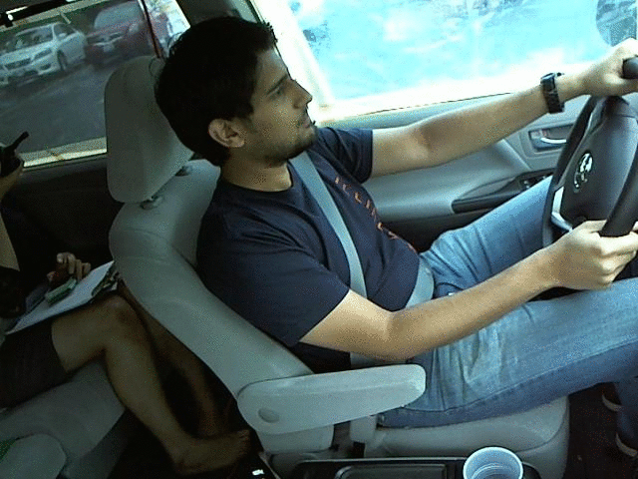
pREDICTION rEFINEMENT uSING tIME SERIES

Slide 19
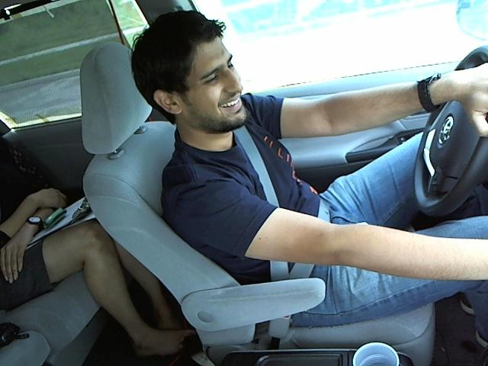
pREDICTION rEFINEMENT uSING tIME SERIES
 | Classification
True | C5 operating the radio
Label | C9 talking to passenger

Slide 20
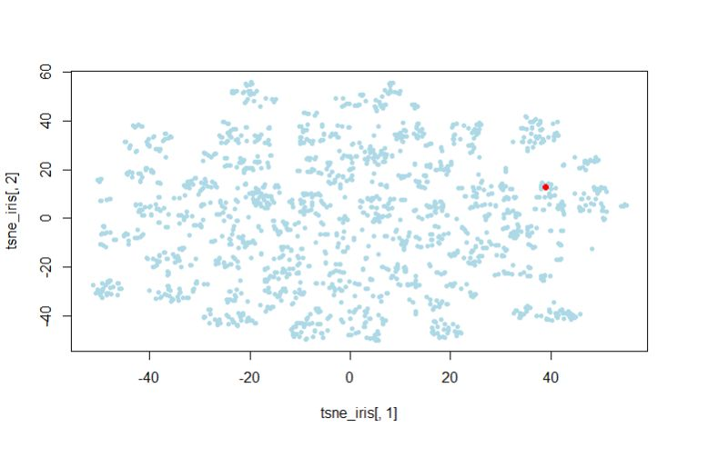
Defective point detection

Slide 21
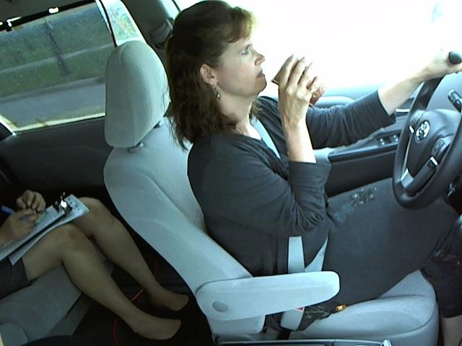
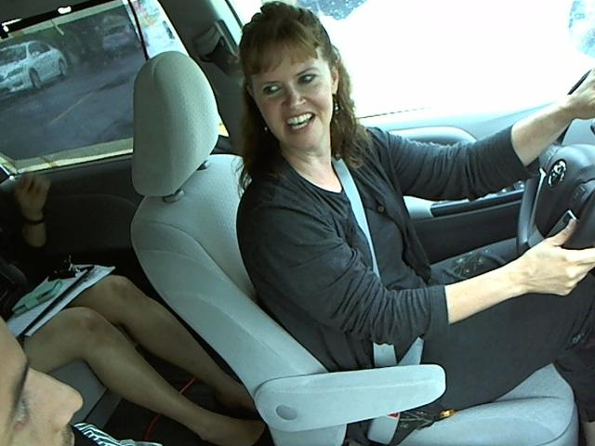
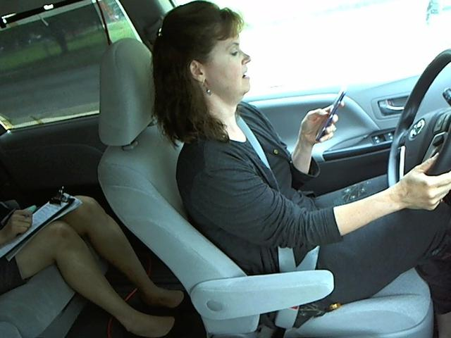
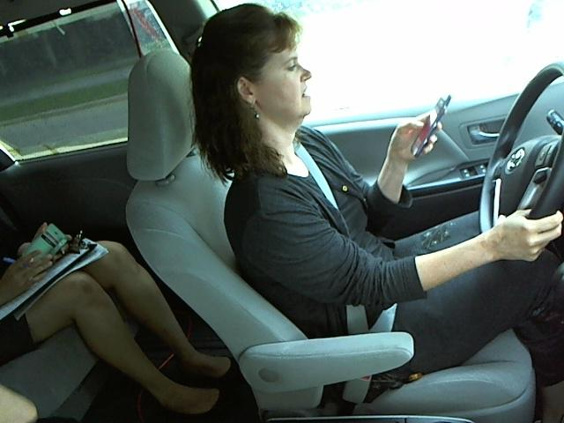
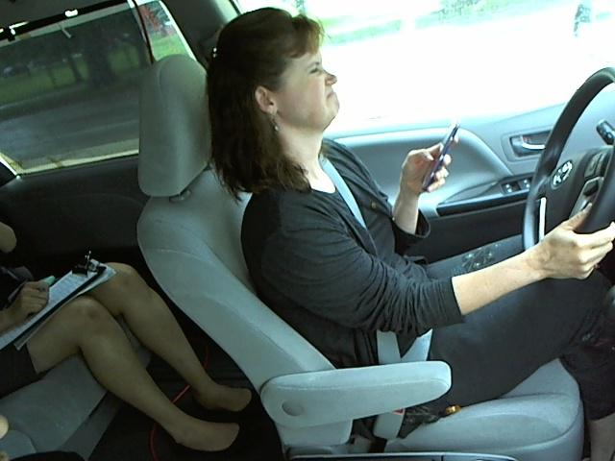
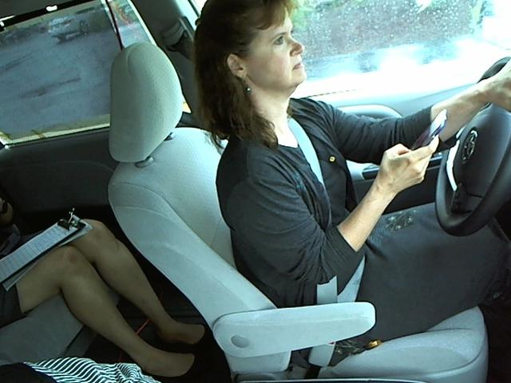
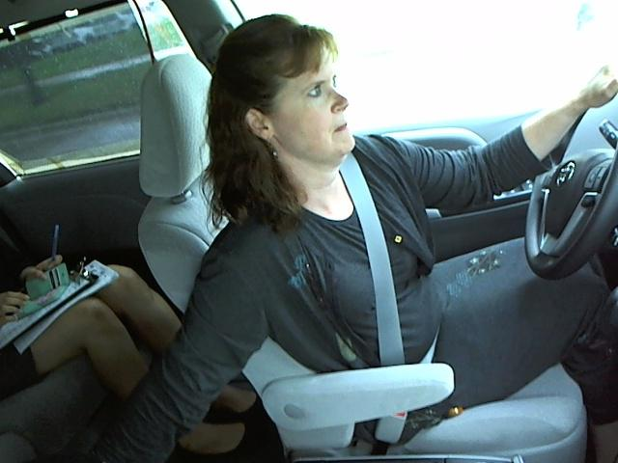
Reach behind
Operating radio
Phone left
Phone left
Phone right
Drinking

Slide 22

Last but not least…
Driver Detection is important.

Slide 23


Last but not least…

Slide 24

Last but not least…

Slide 25

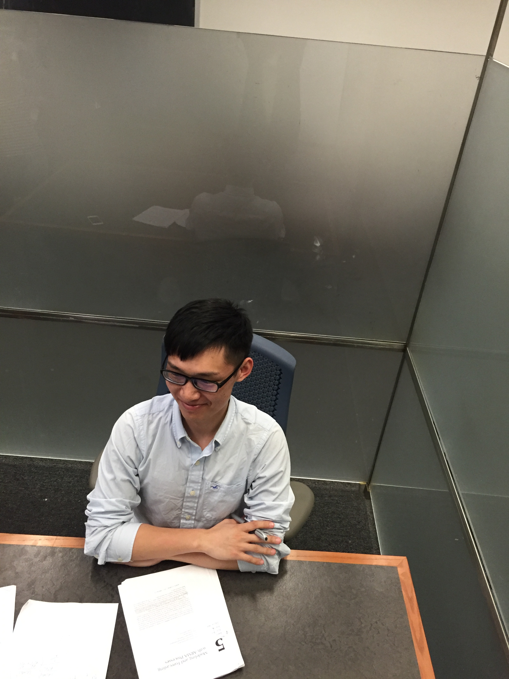
Last but not least…
 | Probability
True | 0.97
False | 0.03
 | Probability
True | 0.04
False | 0.96

Slide 26
Thank You

